Slide 1
^{IDEA EXCHANGE:}
^{Programs and Pedagogy}
June 8, 2016 4:00 PM
Moderator Audrey Shafer, MD
^{Guggenheim}
^{McNay Art Museum}

Slide 2
THE PULSE OF ART
Connections Between the History of Art and the History of Medicine
Collaborating Institutions:
Icahn School of Medicine at Mount Sinai
Solomon R. Guggenheim Museum
New York Academy of Medicine
Presenters:
Bobbi Coller, Ph.D., Department of Education
Icahn School of Medicine at Mount Sinai
Sharon Vatsky, Director of School and Family Programs
Solomon R. Guggenheim Museum
Additional Key Faculty:
Barry S. Coller, M.D., David Rockefeller Professor of Medicine, Vice President for Medical Affairs, Head of the Allen and Frances Adler Laboratory of Blood and Vascular Biology, Physician-in-Chief, The Rockefeller University

Slide 3
The Pulse of Art: Connections Between the History of Art and the History of Medicine
Sponsor:
Academy for Medicine and the Humanities, Icahn School of Medicine at Mount Sinai
Program Goals:
Enhance Observational Skills
Enhance Empathy
Provide a Framework for Understanding the Sweep of Medical History
Course Structure: Elective for Medical Students, Trainees, and Faculty
Enrollment: Course limited to 20 students
Schedule: 11-12 weekly sessions of 90 minutes each
Select topics: Observation in Medicine and Art; Picturing Pandemic Disease; Reading and Misreading Faces; The Ascendancy of American Science and Medicine in the 19th Century; Images of Illness; Skin Deep
Museum and Library Visits: Guggenheim Museum (2) and New York Academy of Medicine Rare Book Room

Slide 4
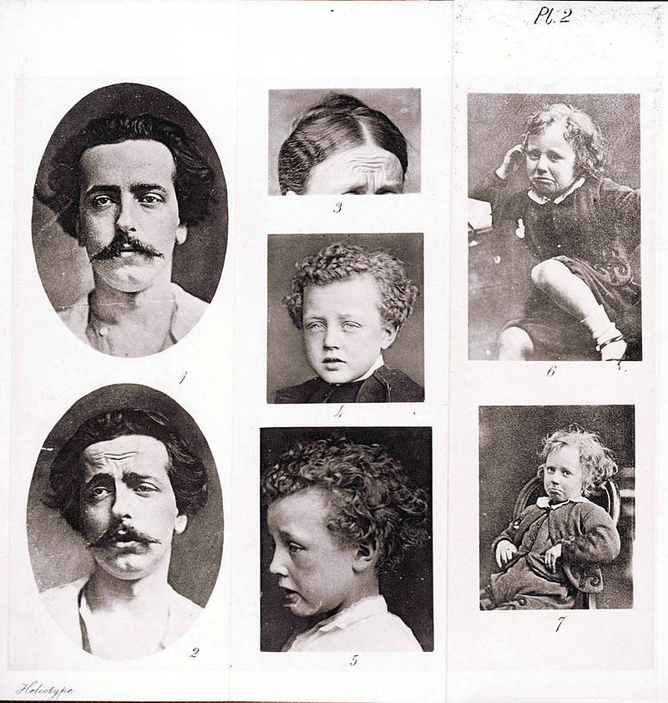
Illustration of grief from The Expression of the Emotions in Man and Animals, Charles Darwin, published by J. Murray, London, 1872. Beinecke Rare Book & Manuscript Library, Yale University.

Slide 5
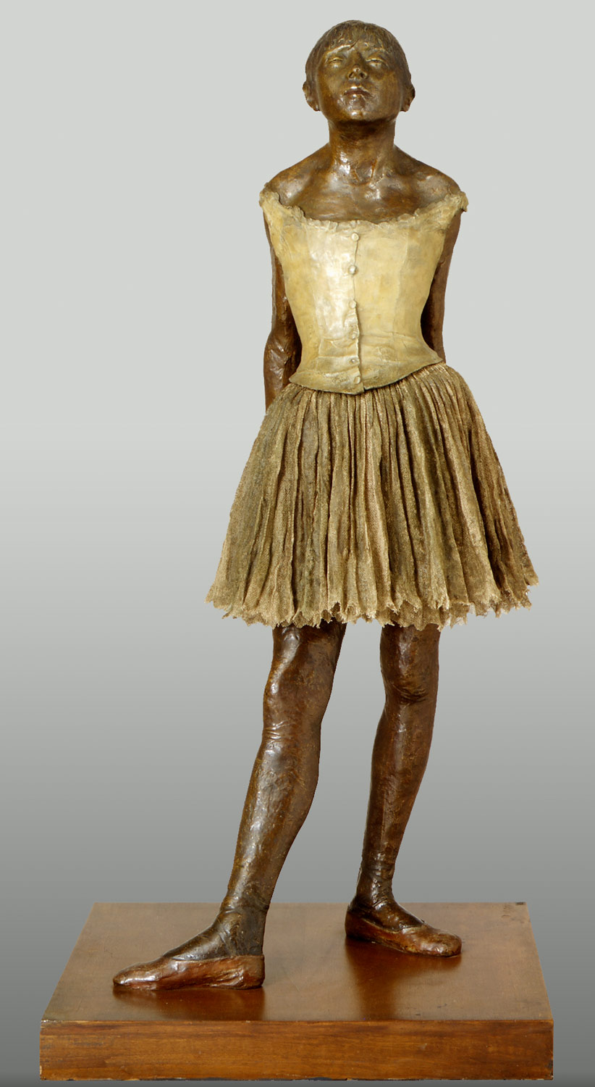
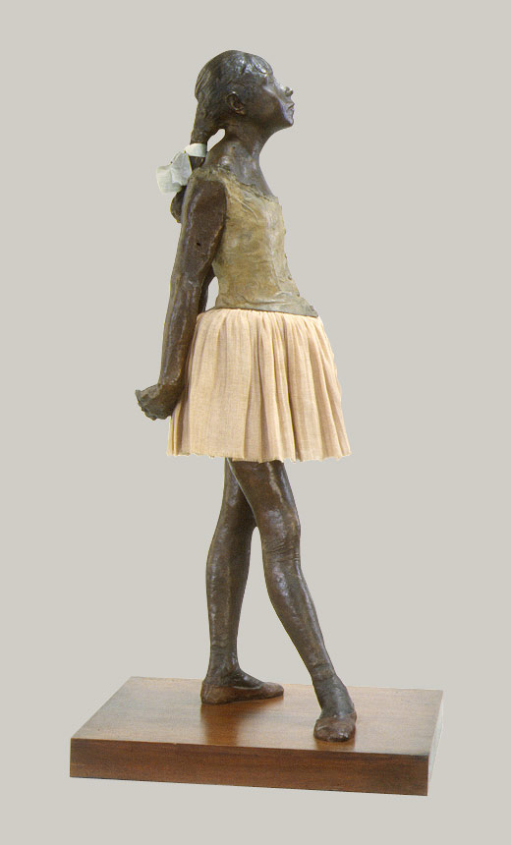
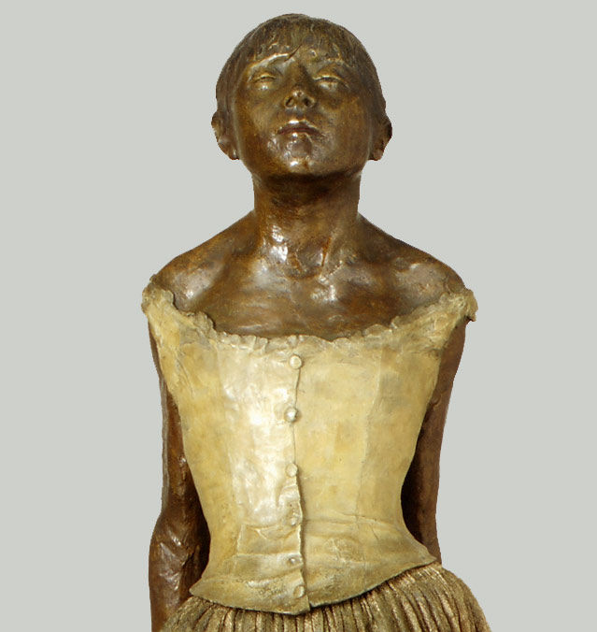
Edgar Degas, The Little Fourteen-Year-Old Dancer, ca. 1880, cast 1922
Bronze, partially tinted, with cotton skirt and satin hair ribbon; wood base, 38 1/2 x 17 1/4 x 14 3/8 in.
Metropolitan Museum of Art, H. O. Havemeyer Collection. NY

Slide 6
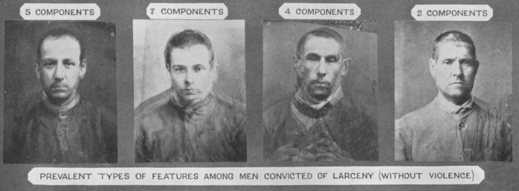
Galton: Composite Photographs of Men Convicted of Larceny (Without Violence)
http://galton.org/composite.htm

Slide 7
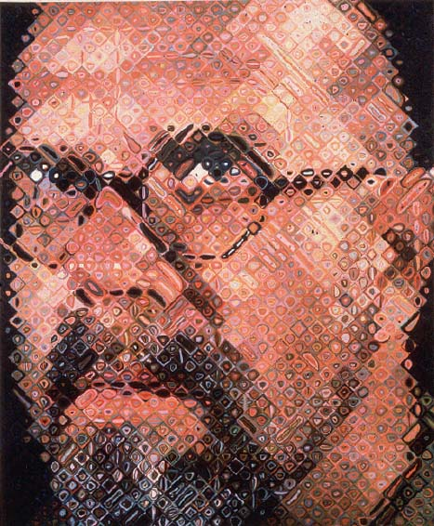
Chuck Close, Self Portrait, 1997, Oil on canvas, 8’6” x 7’ , Museum of Modern Art, NY

Slide 8
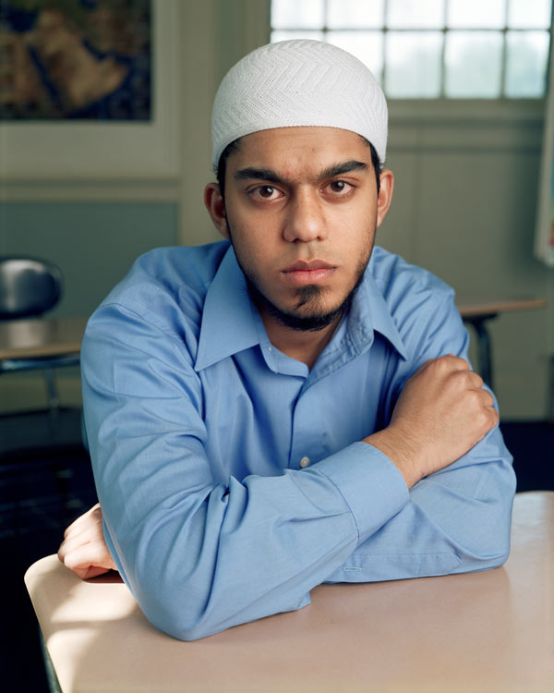
I know that I shouldn’t but sometimes I wonder how other people look at me. What do they see first? My brown-ness, my beard, my cap, my clothes, the color of my eyes, the design of my T-shirt? I think that people see my skin color first. They probably see me as a brown guy. Then, they might see my black beard and my white kufi (prayer cap) and figure out I am Muslim. They see my most earthly qualities first. Brown, that’s the very color of the earth, the mud from which God created us. Sometimes I wonder what color my soul is. I hope that it’s the color of heaven.
Dawoud Bey, Omar, 2005. From Class Pictures (Aperture, 2007). Image courtesy Aperture Foundation.

Slide 9
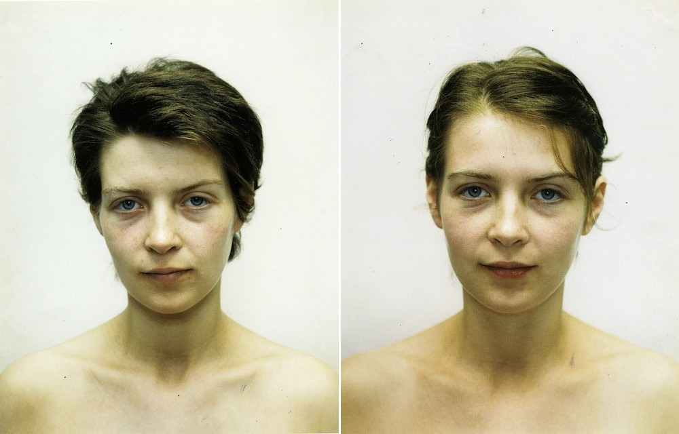
Rinke Dijkstra , Tia, Amsterdam, the Netherlands, 14 November 1994, Tia Amsterdam, the Netherlands, 23 June 1994

Slide 10
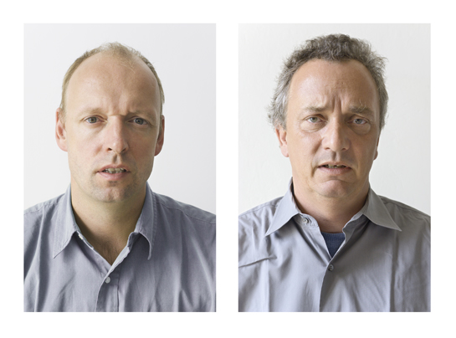
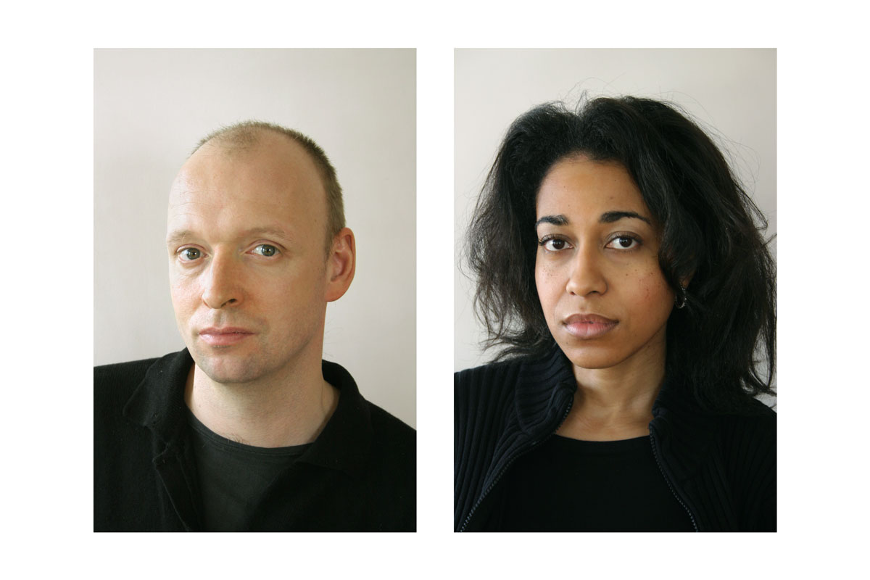
Markus Hansen, Other People's Feelings Are Also My Own, 2004-2006, C-Type print

Slide 11
Evaluation of Course Impact
Goal: Compare the number and empathic content of observations made by students of images before and after the course
Design:
PRE-COURSE
POST-COURSE
50 % IMAGE A
100 % IMAGE A and IMAGE B
50 % IMAGE B
Allows comparison of single student’s responses on same image and new image, and group responses to each image when seen either before or after the course.
Statistical analysis: Paired t test or nonparametric analysis as appropriate
Pilot study of candidate images conducted by Gabriel Slamovits, a Mount Sinai student
21 participants viewed 9 images
Mean number of observations/image = 4.0-6.0; Variances for each image = 3.3-9.1.
Two images were selected based on number of observations (4.8 and 5.1) and similar themes and complexity.
Pilot data used to estimate the required sample size: 24 students required to have an 80% chance of detecting a difference of 1.5 observations between pre- and post-tests.
“Narrative observations” tentatively define as ones in which the student projects motivation or a narrative onto the actions observed.

Slide 13
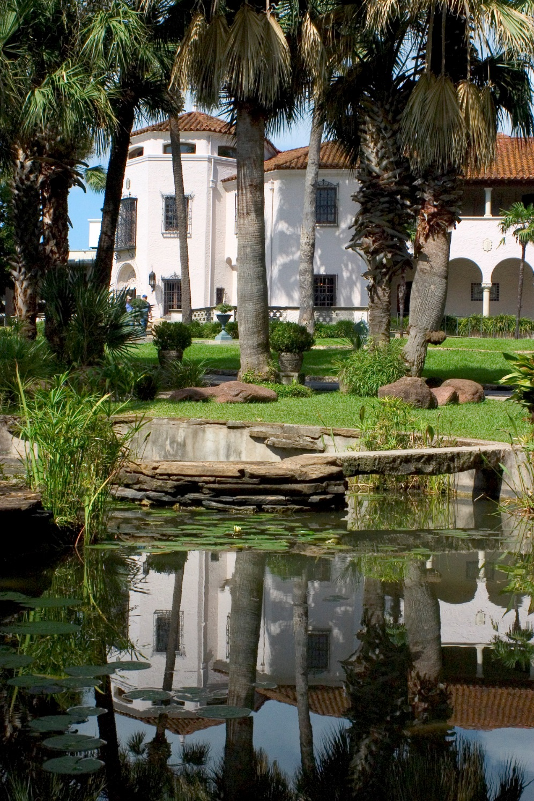
Art Rounds
McNay Art Museum, San Antonio, Texas
Kate Carey, Director of Education
Museum Educators, Rosemary Hickman and Sheena Solitaire
University of Texas Health Science Center
Medical School
Adam Ratner, MD, Reuter Professor of Medical Humanities
Nursing School
Clarice Golightly-Jenkins, PhD, RN, MSN, CNS
Assistant Professor – Clinical, Department of Health Restoration & Care Systems Management
School of Health Professions
Mary Kay Hart, MS, BS, AAS, Assistant Professor/Clinical, Respiratory Care

Slide 14
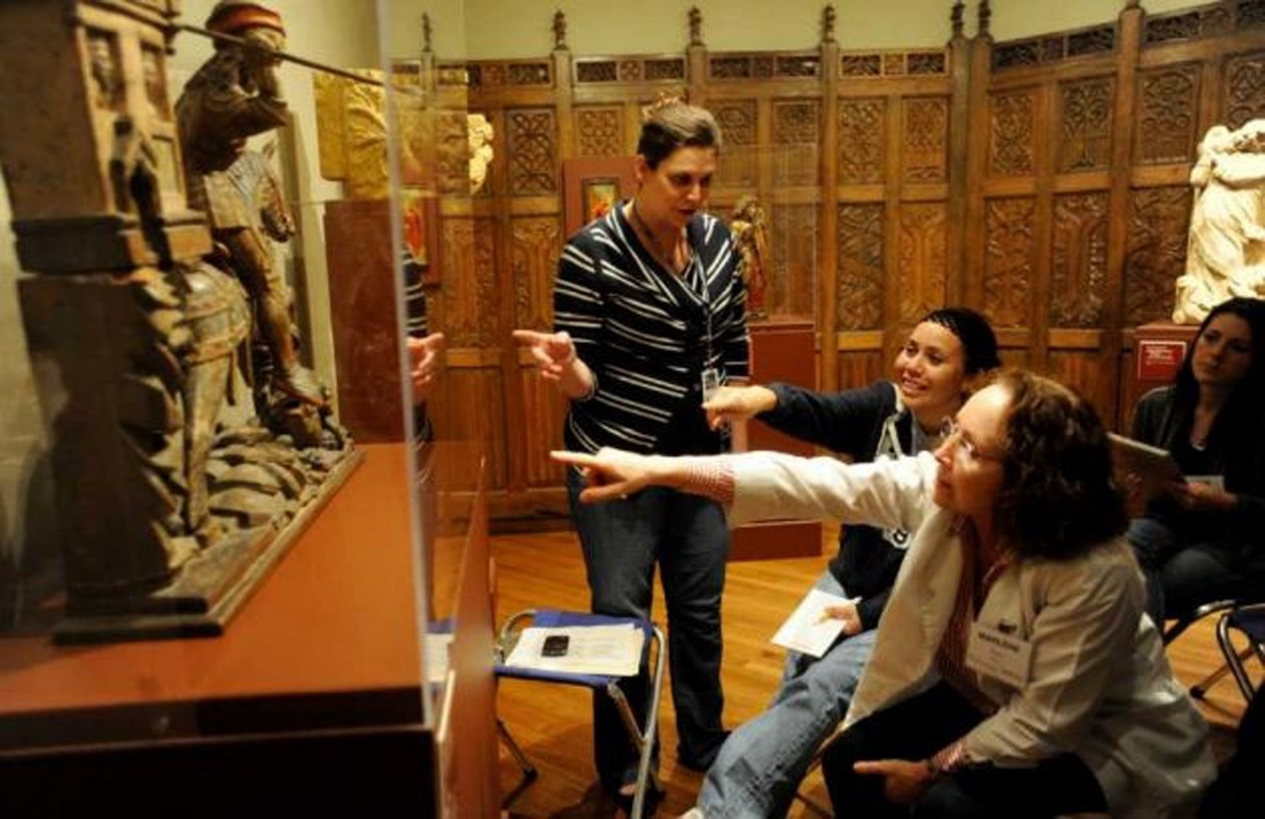
Art Rounds Course Objectives
Improve physical observation skills
Increase comfort with ambiguity
Increase empathy
Enhance communication skills
Foster interprofessionalism

Slide 15
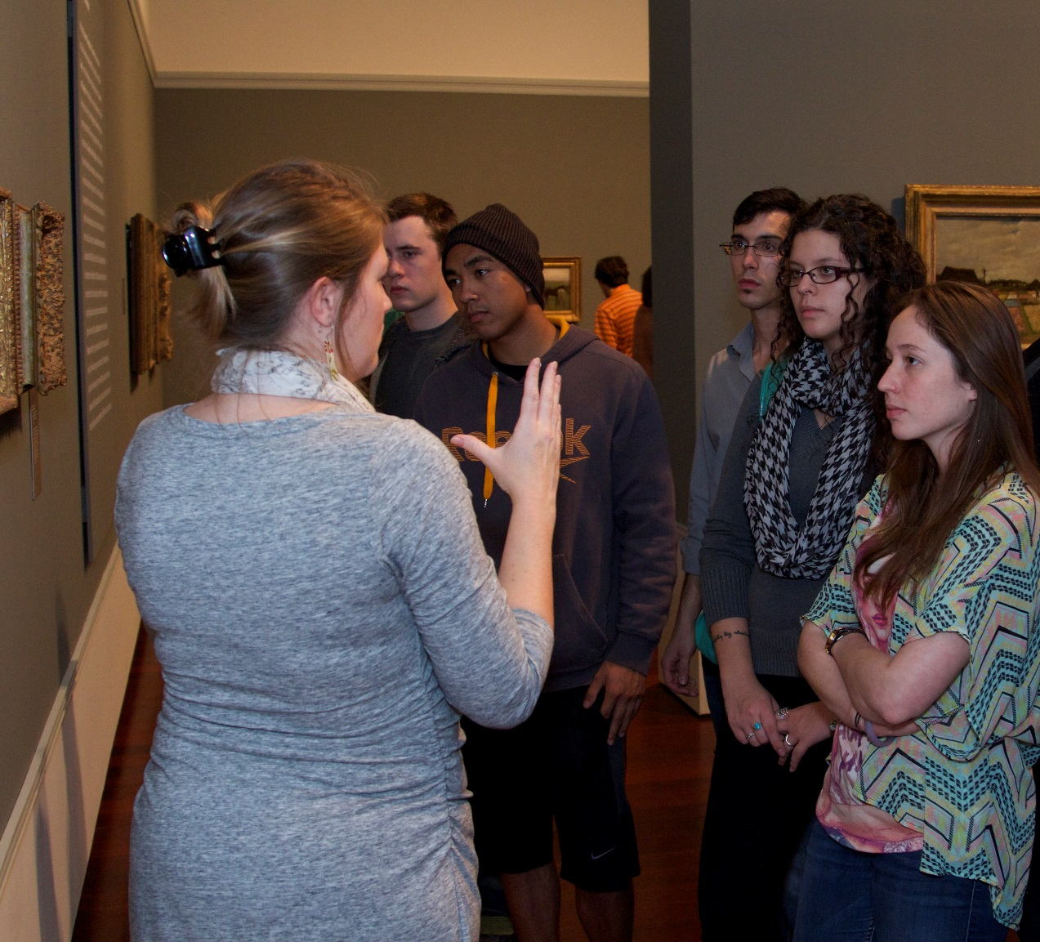
Art Rounds Course Stats
2009–Beginning of partnership
2011–Beginning of elective course
(Medical & Nursing students)
2015–Expansion to Health Profession
25–30 students (roughly equal
distribution from each school)
10 classes with 4 sessions at McNay
Pre and post test via Survey Monkey

Slide 16
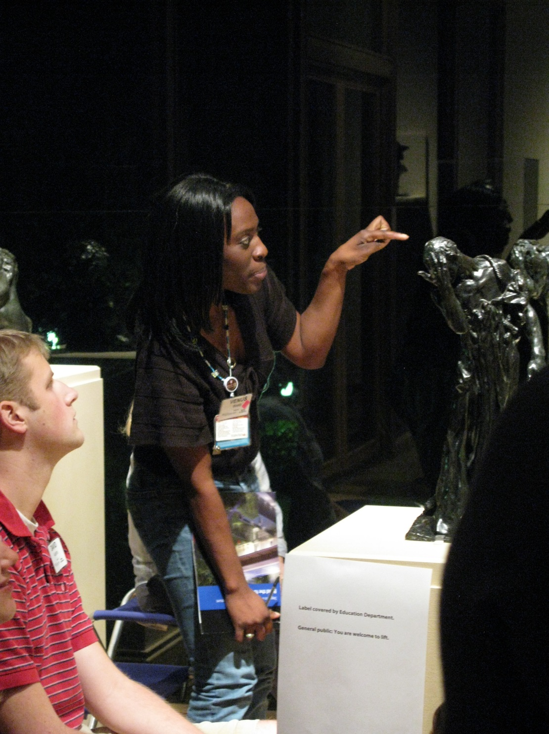
McNay Sessions
Observe the Physical
Play Well with Others
To Ambiguity & Beyond
Patience with Patients
Winning Formula
Warm-up & food
Observation & practice in gallery (VTS)
Group debrief
Assignment with partner

Slide 17
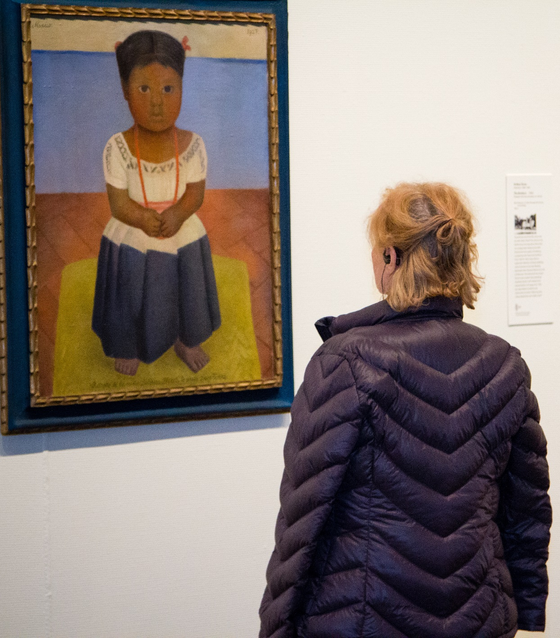
Session I: Observe the Physical
Describe ordinary object
(7 adjectives)
Model & Practice VTS
Find & describe art patient with partner. (Resist urge to Google.)
Session II: Play Well with Others
Pocket museum
VTS with emphasis on peer comments
Share & discuss art patient with others

Slide 18
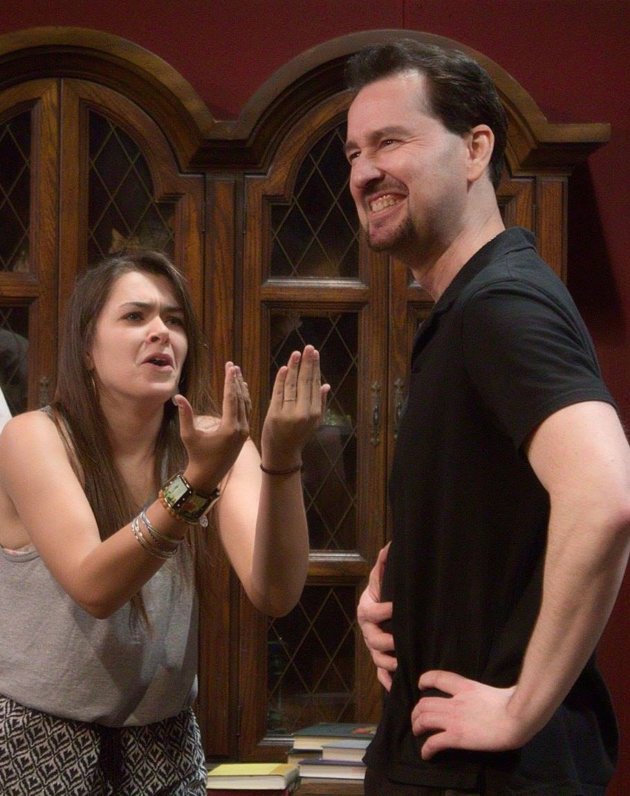
Session III: To Ambiguity & Beyond
Mystery object in a brown bag
Gallery practice with Active Looking, Choices, Connections, Possibilities
Share art patient with peers
Session IV: Patience with Patients
Make observations about actor
Conduct differential diagnosis with assigned portraits
Google art patient (and artist)
Scotty Walker, Improv Actor, The Denials

Slide 19
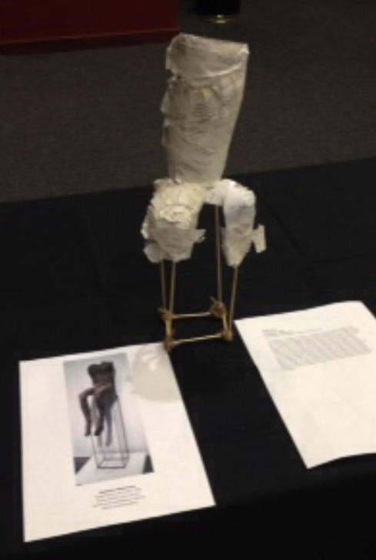
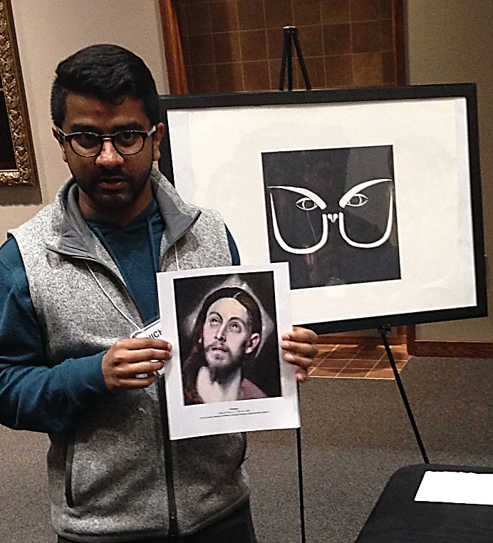
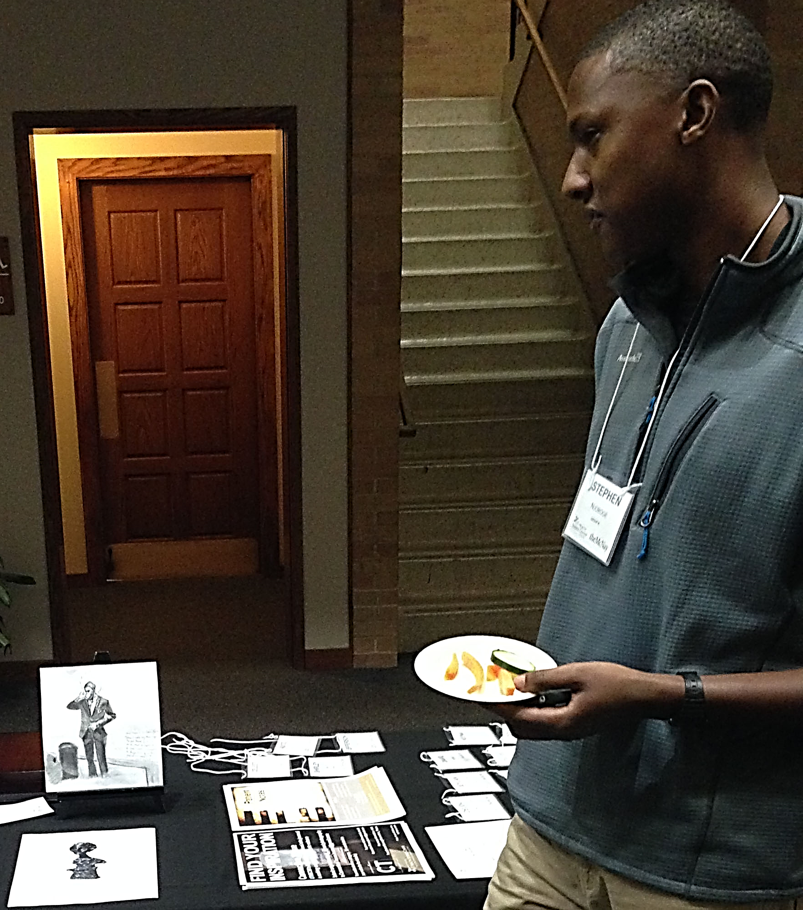
Last Class: Creative Responses
Use art patient as inspiration
Make a creative response to patient
Share with peers

Slide 20
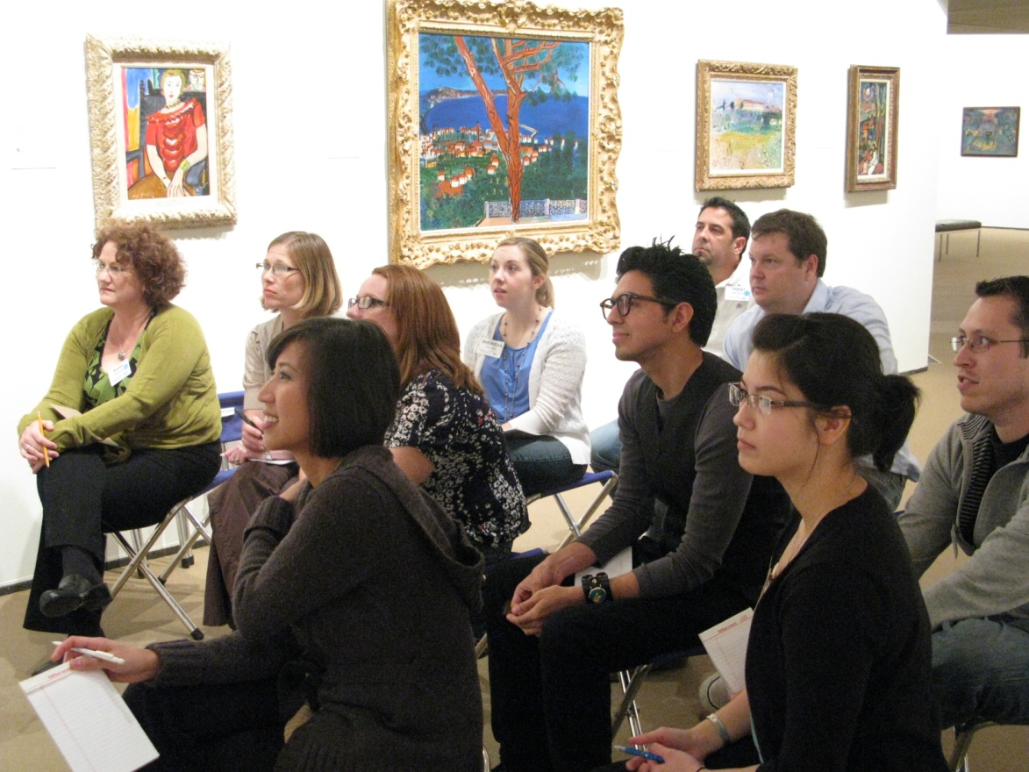
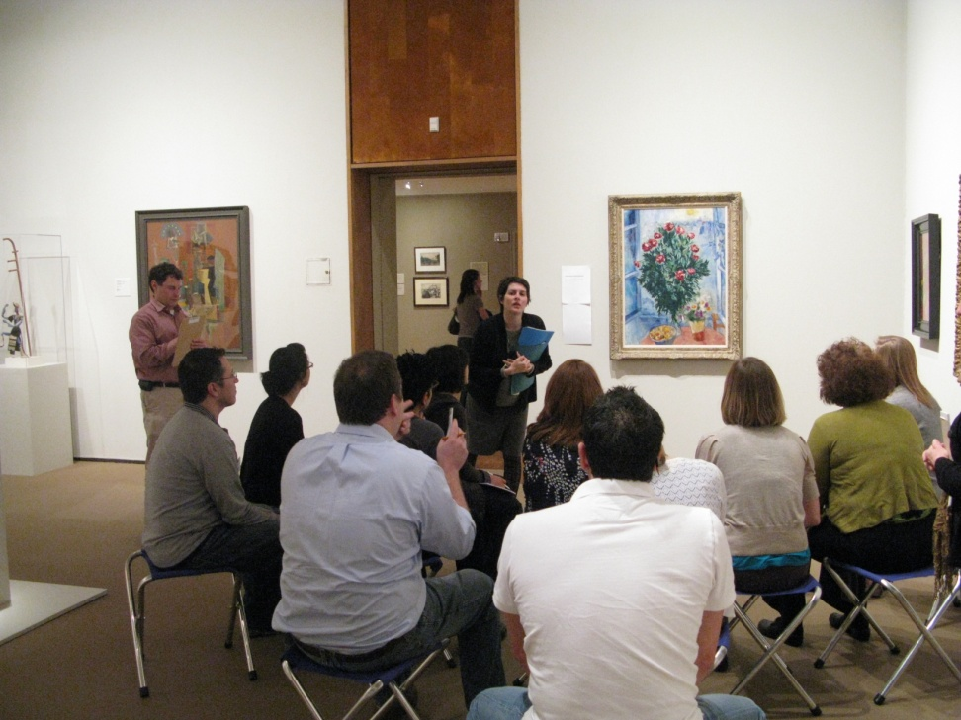
Art Rounds Results
Interprofessional collaboration
Evaluation Research, 2010
- Increase in time spent on post-test
compared to pre-test
- Increase in number of observations and
amount of words post-test to pre-test
- Improvement in comfort with ambiguity
- Improvement in communication skills
- Increase in comfort with
interprofessional communication

